Slide 1





Session Analog to Digital Convertor
By : Ahmad Hazem

Slide 2

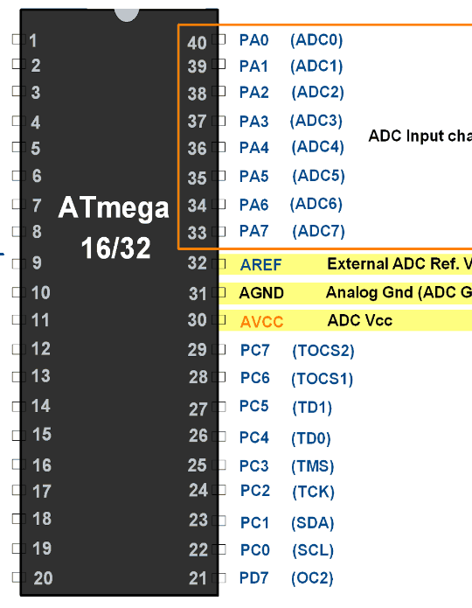
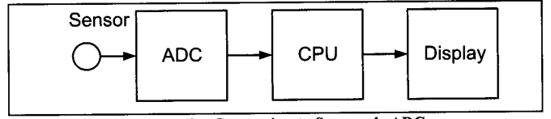
ADC pinout
PORTA in the atmega32 consists of 8 channels, allowing up to 8 peripherals to be connected to the microcontroller.

Slide 3
Conversion Time : Conversion Time is the time taken by the ADC to convert the analog input into a binary digital input. The conversion time is dictated according to the clock frequency connected to it. Also, it can be called the sampling time.
Vref : It is the input voltage used as a reference voltage for the ADC

Slide 4
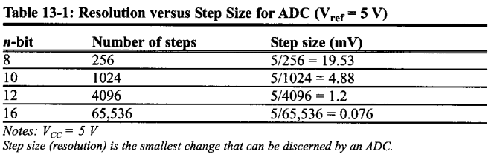

Resolution :
The ADC in the atmega32 has a 10-bit resolution. The ADC resolution is defined as the smallest incremental voltage that can be recognized and thus causes a change in the digital output. It is expressed as the number of bits output by the ADC.
Formula to calculate resolution is $\frac{V_{ref}}{2^{n}} where n is the size of register in bits$

Slide 5
Atmega32 ADC features
10-bit Resolution
13 µs - 260 µs Conversion Time
8 Multiplexed Single Ended Input Channels
7 Differential Input Channels
2 Differential Input Channels with Optional Gain of 10x and 200x
Optional Left adjustment for ADC Result Readout
0 - VCC ADC Input Voltage Range
Selectable 2.56V ADC Reference Voltage
Free Running or Single Conversion Mode
ADC Start Conversion by Auto Triggering on Interrupt Sources
Interrupt on ADC Conversion Complete

Slide 6

ADCH/ADCL (ADC data register)
It is a 10-bit register composed of 2 8-bit registers. One register holds the LSB 8-bit in it (ADCL for an example), and the other register holds the MSB 2-Bit in it (ADCH for example).

Slide 7
ADMUX Register
Bit 7: 6 – REFS1 : 0: Reference Selection Bits
Reference voltage selection for ADC
REFS1 | REFS0 | Description
0 | 0 | AREF pin
0 | 1 | AVCC pin i.e. Vcc 5 V
1 | 0 | Reserved
1 | 1 | Internal 2 (2.56 V)

Slide 8
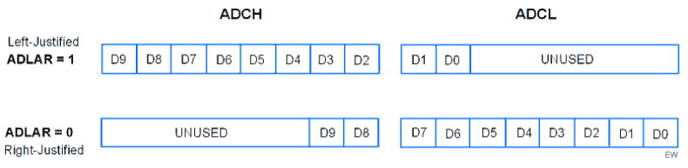
ADMUX Register
Bit 5 – ADLAR: ADC Left Adjust Result
Use 10-bits output as upper bits or lower bits in ADCH & ADCL.

Slide 9
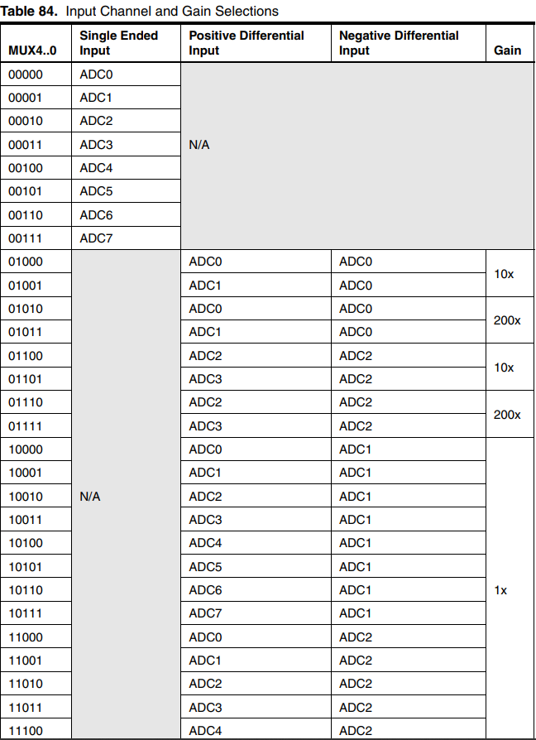
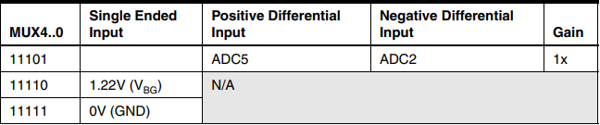
ADMUX Register
Bits 4 : 0 – MUX4 : 0: Analog Channel and Gain Selection Bits
We can select input channel ADC0 to ADC7 by using these bits.
Selecting a channel is very easy, just put the channel number in MUX4 : 0.
Suppose you are connecting the input to ADC channel 2 then put 00010 in MUX4 : 0.
Suppose you are connecting the input to ADC channel 5 then put 00101 in MUX4 : 0.

Slide 10
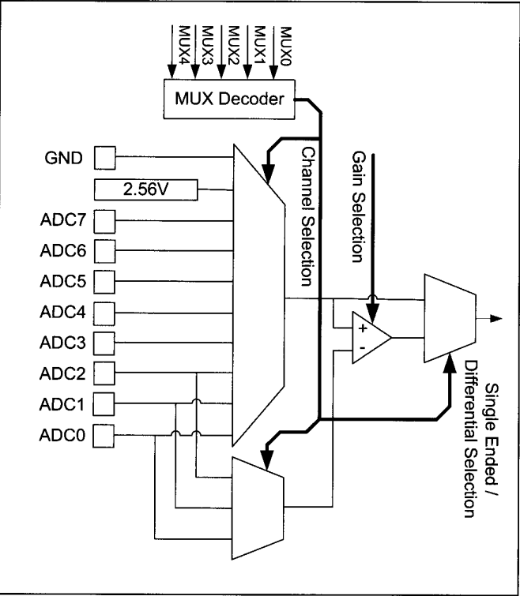

Slide 11

ADCSRA Register
Bit 7 – ADEN: ADC Enable
Writing one to this bit enables the ADC. By writing it to zero, the ADC is turned off. Turning the ADC off while a conversion is in progress, will terminate this conversion.
Bit 6 – ADSC: ADC Start Conversion
Writing one to this bit starts the conversion.
Bit 5 – ADATE: ADC Auto Trigger Enable
Writing one to this bit, results in Auto Triggering of the ADC is enabled.
Bit 4 – ADIF: ADC Interrupt Flag
This bit is set when an ADC conversion completes, and the Data Registers are updated.
Bit 3 – ADIE: ADC Interrupt Enable
Writing one to this bit, the ADC Conversion Complete Interrupt is activated.

Slide 12
ADCSRA Register
Bits 2 : 0 – ADPS2 : 0: ADC Pre-scaler Select Bits
These bits determine the division factor between the XTAL frequency and the input clock to the ADC
Note frequency the atmega32 can support for conversion rate is 50kHz to 200KHz so , when using the internal clock of the atmega32 (16MHz) we always use the pre-scale of 128, unless an external is oscillator is connected.
ADPS2 | ADPS1 | ADPS0 | Description
0 | 0 | 0 | 2
0 | 0 | 1 | 2
0 | 1 | 0 | 4
0 | 1 | 1 | 8
1 | 0 | 0 | 16
1 | 0 | 1 | 32
1 | 1 | 0 | 64
1 | 1 | 1 | 128

Slide 13
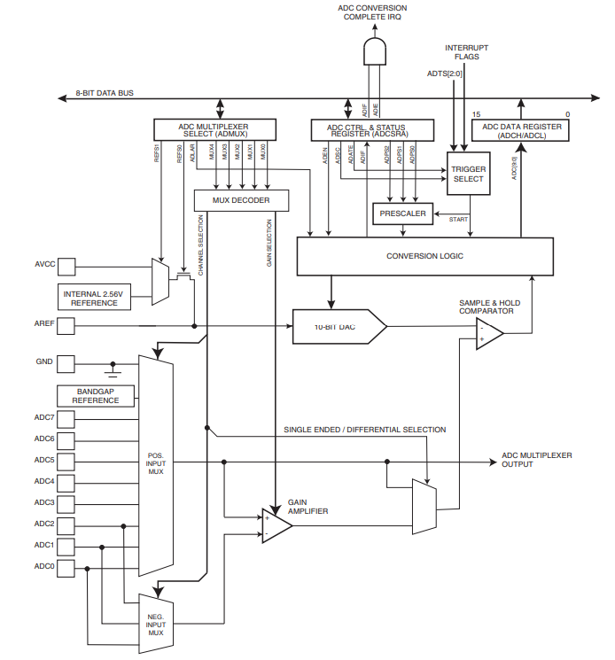

Slide 14


SFIOR register (Special Function input output register)
ADTS2 | ADTS1 | ADTS0 | Description
0 | 0 | 0 | Free Running mode
0 | 0 | 1 | Analog Comparator
0 | 1 | 0 | External Interrupt Request 0
0 | 1 | 1 | Timer/Counter0 Compare Match
1 | 0 | 0 | Timer/Counter0 Overflow
1 | 0 | 1 | Timer/Counter1 Compare Match B
1 | 1 | 0 | Timer/Counter1 Overflow
1 | 1 | 1 | Timer/Counter1 Capture Event
Bits 7,6,5 : ADTS2, ADTS1, ADTS0:
The ADTSn bit are trigger bits for the ADC to convert the analogue voltage strobed on the ADC channel pin into a decimal value stored in the ADCH/ADCL data register.

Slide 15
LM35 Temperature sensor
Write an AVR c code to interface LM35 with atmega32. when temperature is more than 50 degree Celsius, make a LED connected to port C pin 0 go on;
Create a fire alarm system using LM35 temperature system, IR flame sensor, LCD , buzzer, LED. Display temperature, gas sensor on the LCD . If temperature is above 50 ,and flame is detected set buzzer on , and LED to flicker

Slide 16

Interrupts

Slide 17
Interrupts (Exceptions handling by CPU)
Exceptions
Hardware (External interrupts - RESET)
Software (Division by zero – stack overflow)

Slide 18
Reset circuit and watch dog timer
Watch Dog Timer :
Counter that count time period for each function .If function took more than calculated time period, an automatic reset occurs.
RESET
Hardware
Watch dog timer
External Interrupt
Software

Slide 19
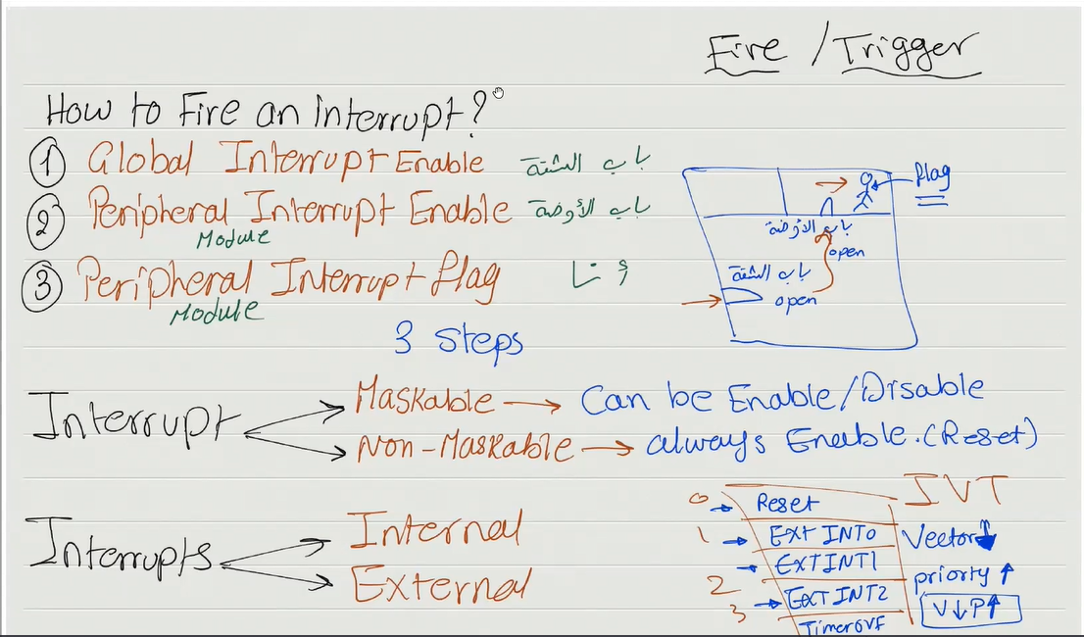

Slide 20
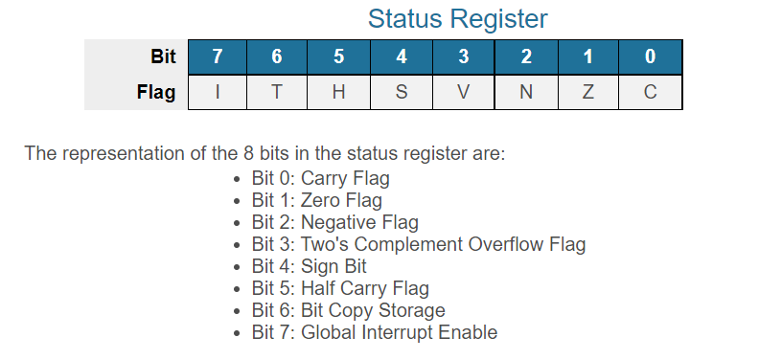

Slide 21
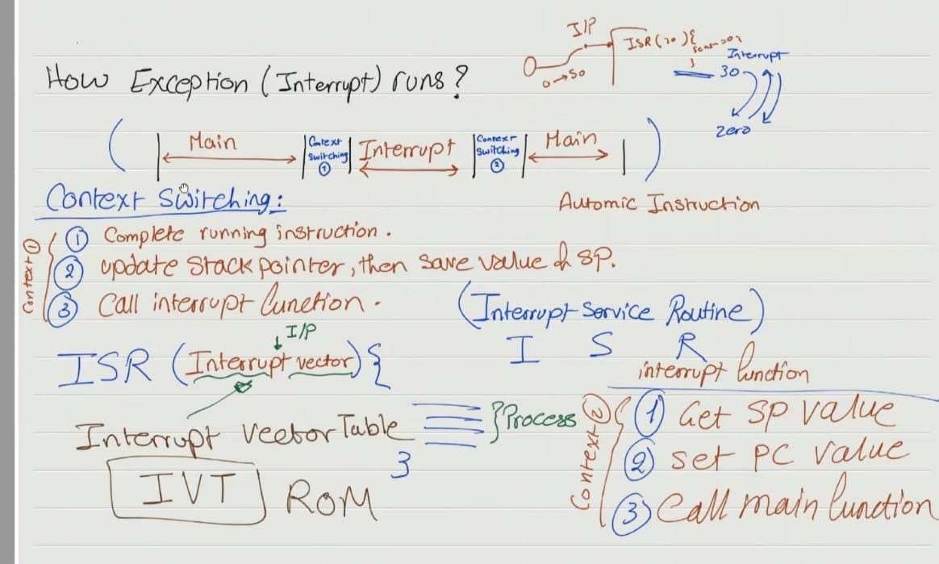

Slide 22
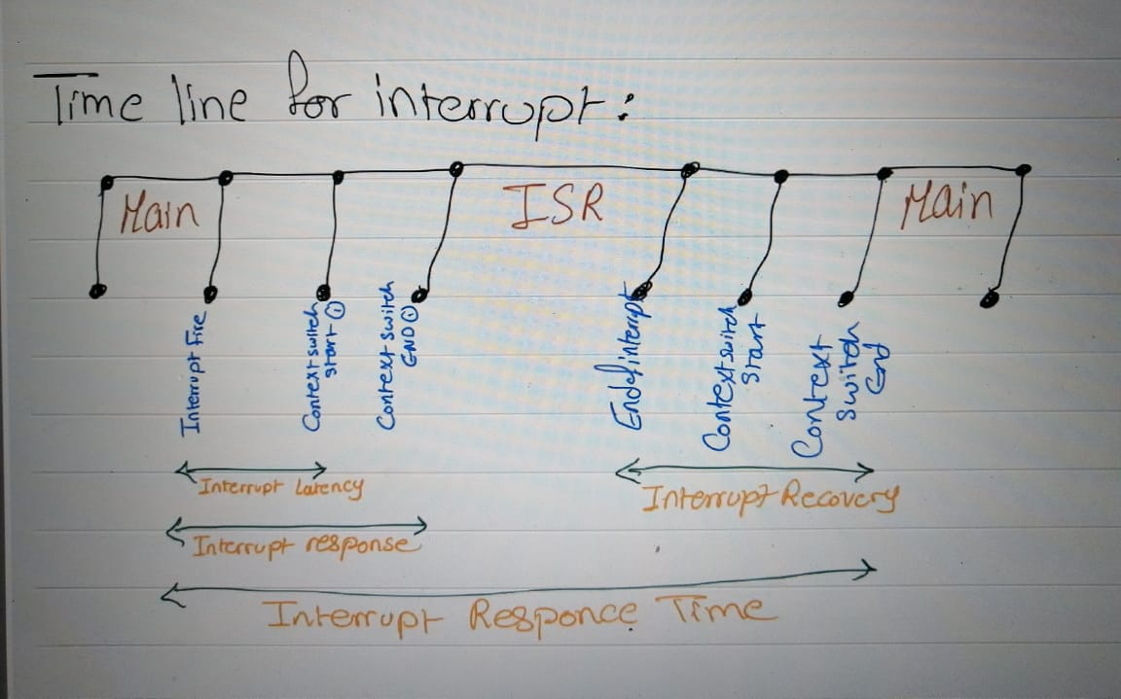

Slide 23
Definitions:
Interrupt latency: Time between interrupt happens and context switching start
Interrupt response time : Time between Interrupt happens and ISR function start running.
Interrupt Recovery : Time between interrupts and context switching finish
Interrupt Process Time : Time between interrupts happens and the returning of the main function

Slide 24
External Interrupts

Slide 25

GICR Registers
Bit 7 – INT1: External Interrupt Request 1 Enable
0: Disable external interrupt
1: Enable external interrupt
Bit 6 – INT0: External Interrupt Request 0 Enable
0: Disable external interrupt
1: Enable external interrupt
Bit 5 – INT2: External Interrupt Request 2 Enable
0: Disable external interrupt
1: Enable external interrupt

Slide 26

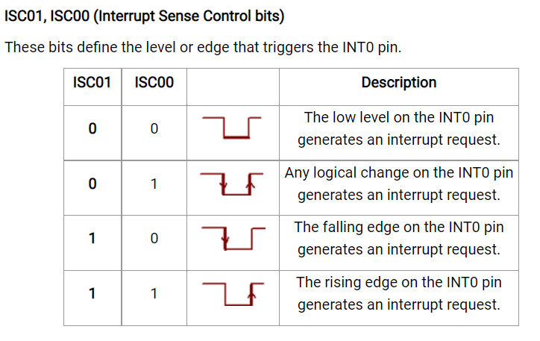
MCU Control Register (MCUCR)

Slide 27
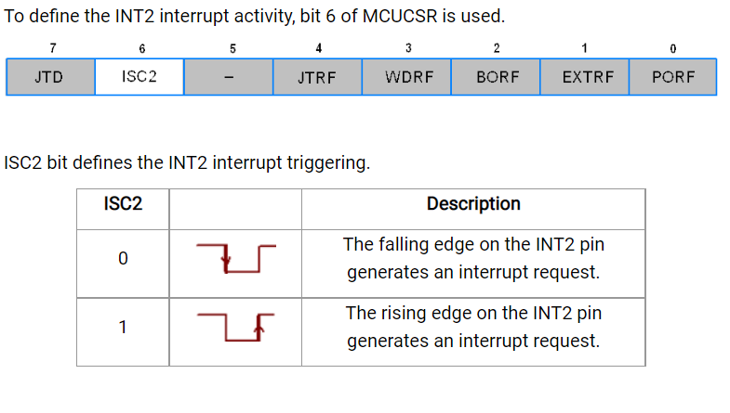
MCU Control and Status Register (MCUCSR)

Slide 28
Examples
Write an AVR c code that enables a LED when a push button is pushed using an interrupt.
Write an AVR c code interrupt code when a button is pushed in the keypad , the letter appears on the LCD

